Slide 1
User Experience Design for a web solution
Contents:
User Experience Site Map
Wireframe Screen Mock-Up
Wireframe Screen/Field Validations
SOA Web Service call on “Submit” buton click

Slide 2
UX design extract from a real-life web solution
Basis for producing UX designs:
UX requirements are derived from business requirements. The desired screen layout, look and feel is achieved by initially deriving the UX site map and then mocking up the screens and the associated screen/field validations as wireframes which would act as a blue print.
A module from Web CRM solution to elaborate UX design:
Enable call center advisors to locate customer account and advise of their outstanding balance
Scope of this document:
This document elaborates:
The complete site map for the above module,
Wireframe screen mock-up for only the customer search screen out of the total 4 screens &
Screen/field validations of customer search screen only.
SOA Web Service Request-Response call on “Submit” button click.

Slide 3
UX Sitemap
To enable call center advisors to locate customer account and advise of their outstanding balance
Customer search screen
Search Results screen
Enter search criteria and click Search button
Click on customer record
View Balance
Click on view balance link
Customer Details screen

Slide 4
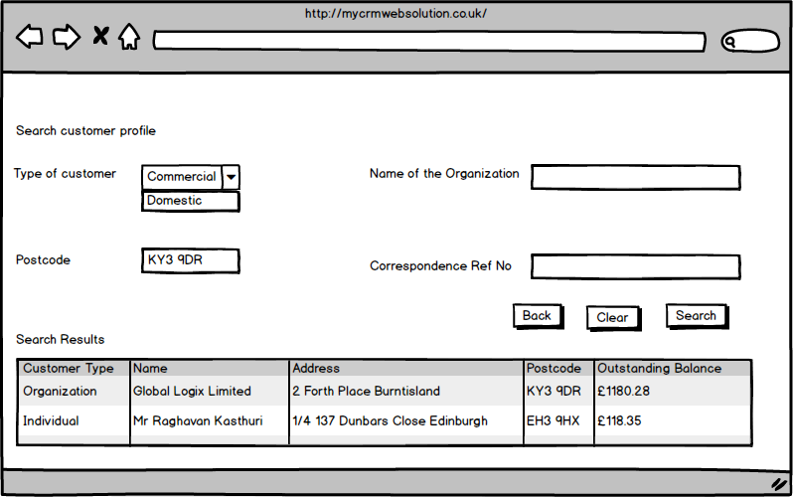
Wireframe Screen Mock Up Screen Name: Customer Search

Slide 5
Wireframe Screen/Field Validations Screen Name: Customer Search
Field Validations
Screen validations
Atleast one of Type Of Customer or Name of Organization or Postcode or Customer Ref No is mandatory.
Clicking on “Search” button displays customer search results if any.
Clicking on “Search” button displays “No results found” in case there were no customers matching the search criteria.
Clicking on “Back” button navigates the screen back to the Home Page.
Clicking on “Refresh” button clears all the search criteria entered on screen.
Entering no search criteria and clicking on “Search” button displays an appropriate error message on top of the screen.
Entering erroneous type of characters on fields should automatically display an error message even before clicking “Search”
Field Name | Type of customer | Name of the organization | Postcode | Customer Ref No
Field Type | Drop down | Text Box | Text Box | Text Box
Mandatory ? | No | No | No | No
Type of Characters | Alphanumeric | Alphanumeric | Alpha numeric | Alphanumeric
Field Length | N/A | 1000 | 9 | 11

Slide 6
Synchronous Request-Response Web Service call
Customer search by one or more parameters to display customer search results within a few seconds of clicking the “Search” button. A synchronous web service call expecting a response in seconds of placing the request.
Clicking on “Search” button from web screen of CRM invokes customerSearch (String customerName, String postCode, String businessName, String correspondenceRefNo) returns an array of customers who match the search criteria.

